Slide 1
Chapter 4 - Intermolecular forces
and the liquide state
Chapter 16 Liquids and Solids
16.1 Intermolecular forces
16.2 The liquid state

Slide 2
Introduction
A phase is a physical state of matter described by a characteristic relationship between atoms and molecules.
The 3 states of matter are:
Gases:
particles far apart from each other;
particles in random motion;
particles exerting relatively small forces on each other;
low densities, high compressibilities;
completely fill a container
- kinetic molecular theory to account for ideal behavior that real gases approach at high temperatures and low pressures.

Slide 3
Introduction
Solids:
greater densities;
compressible only to a very slight extent;
rigid;
maintain their shapes irrespective of the container
solid components are close together and exert large attractive forces on each other.
Liquids:
-properties in between those of gases and solids, but not midway.
H₂O (s) H₂O (l) ΔH°_{fus}= 6.02 kJ/mol
H₂O (l) H₂O (g) ΔH°_{vap}= 40.7 kJ/mol
These values show a much greater change in structure in going from the liquid to the gas than in going from the solid to the liquid.
In liquids: extensive attractive forces among the molecules similar to but not as strong as those in the solid state.

Slide 4
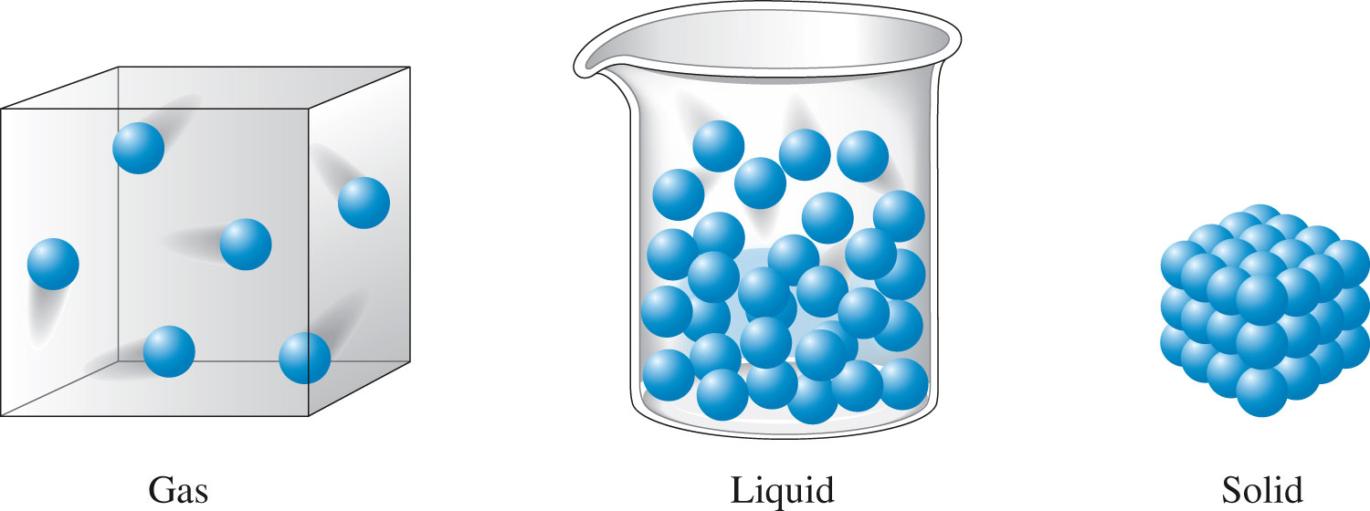
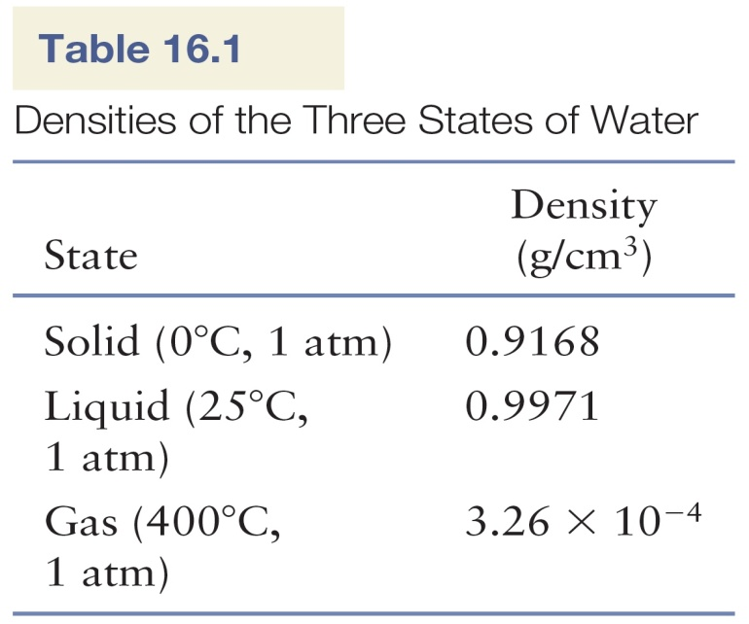
Introduction
Many similarities between solids and liquids and tredementous differences from the gaseous state.

Slide 5
Intermolecular forces
Forces that cause the aggregation of the components of a substance to form a liquid or a solid.
Example:
Water (s) (l) (g) the molecules remain intact changes occur in the forces among the molecules rather than within the molecules.

Slide 6
Intermolecular forces
From the Strongest to the weakest
Ionic Forces: Between Metal + Nonmetal, in ionic compounds
Hydrogen Bond : Molecules must have FH or OH or NH
Dipole Dipole in polar molecules, different electronegativity
London dispersion: In nonpolar molecules and noble gases.
Strongest means: highest Bp, mp, solubility in water, but lowest vapor pressure

Slide 7
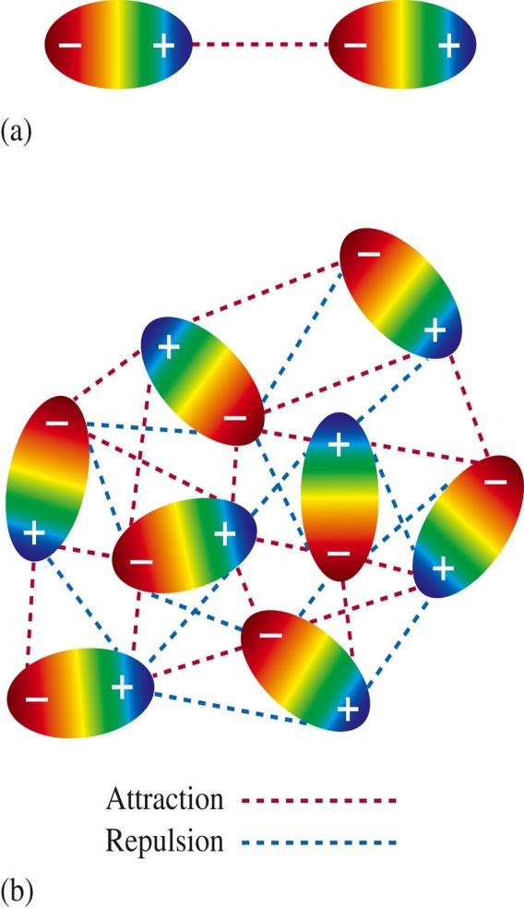
Intermolecular forces
Dipole-dipole forces
When electrons that make up a bond are not equally shared because of a difference in electronegativity → molecules with polar bonds.
Molecules with dipole moments find the best compromise between attraction and repulsion.
Figure 16.2 - (a) The electrostatic interaction of two polar molecules. (b) The interaction of many dipoles in a condensed state.

Slide 8
Intermolecular forces
Dipole-dipole forces
1% as strong as covalent or ionic bonds;
They become weaker as the distance between the dipoles increases;
At low pressures in the gas phase, these forces are unimportant.

Slide 9
Intermolecular forces
Dipole-dipole forces
However
They are strong in molecules in which hydrogen is bound to a highly electronegative atom (F, O, N):
(1) Great polarity of the bond
(2) Close approach of the dipoles due to the small size of the hydrogen atom
Unusual strong dipole-dipole attraction hydrogen bonding usually presented using a dashed line.

Slide 10
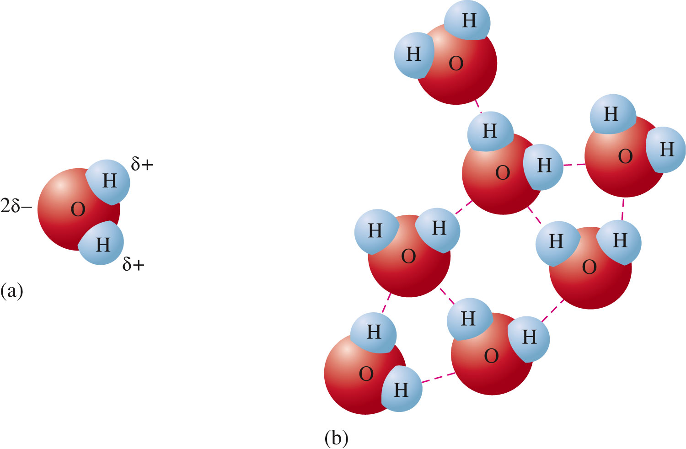
Intermolecular forces
Hydrogen bonding
Figure 16.3 - (a) The polar water molecule. (b) Hydro- gen bonding among water molecules. Note that the small size of the hydrogen atom allows for close interactions.

Slide 11
Intermolecular forces
London dispersion forces
Even molecules without dipole moments must exert forces on each other (H₂, CH₄, CCl₄, CO₂);
All substances, even the noble gases, exist in the liquid and solid states under certain conditions;
The weak forces that exist among noble gas atoms and nonpolar molecules are called London Dispersion Forces;
Temporary dipolar arrangement of charge can occur which can in turn affect the electron distribution in a neighboring atom.

Slide 12
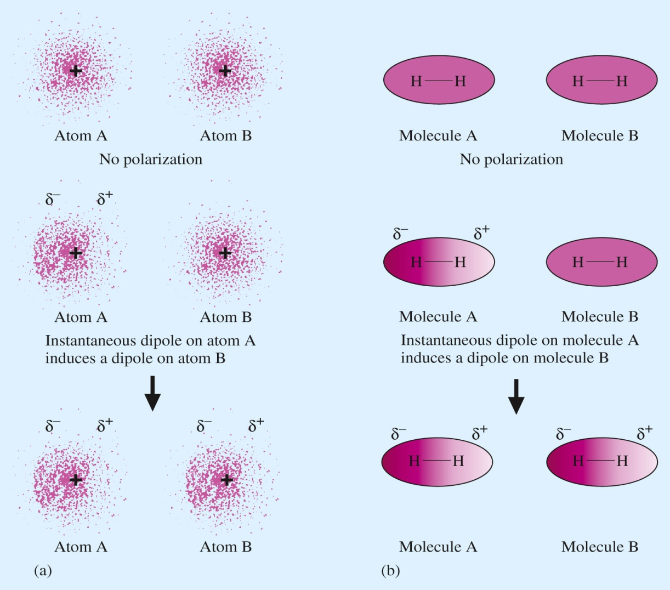
Intermolecular forces
London dispersion forces
Example: H₂, CH₄, CCl₄, CO₂
Figure 16.5 - (a) An instantaneous polarization can occur on atom A, creating an instanta-neous dipole. This dipole creates an induced dipole on neighboring atom B. (b) Nonpolar molecules such as H₂ can develop instantaneous and induced dipoles.

Slide 13
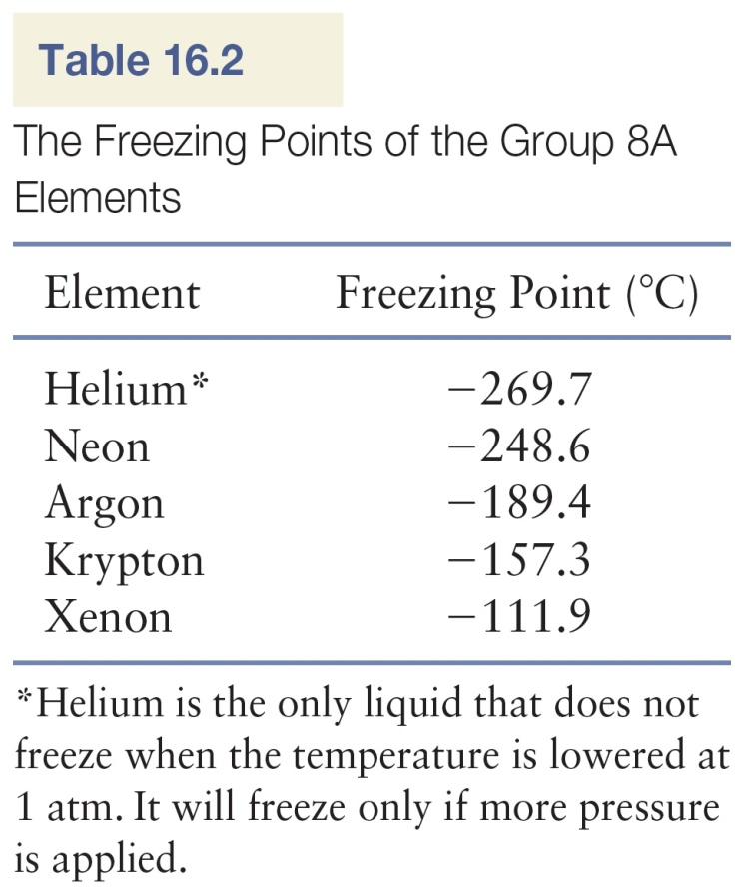
Intermolecular forces
London dispersion forces
This interatomic attraction is both weak and short-lived but that can be very significant for large atoms.
These interactions to become strong enough to produce a solid, the motion of the atoms must be greatly reduced (low freezing points for the noble gas).
The freezing point rises going down a group since the mass increases, the number of electrons increases → increased chance of the occurrence of momentary dipoles.
Large atoms with many electrons exhibit a higher polarizability than small atoms.
London dispersion forces greatly increases as atomic size increases.

Slide 14
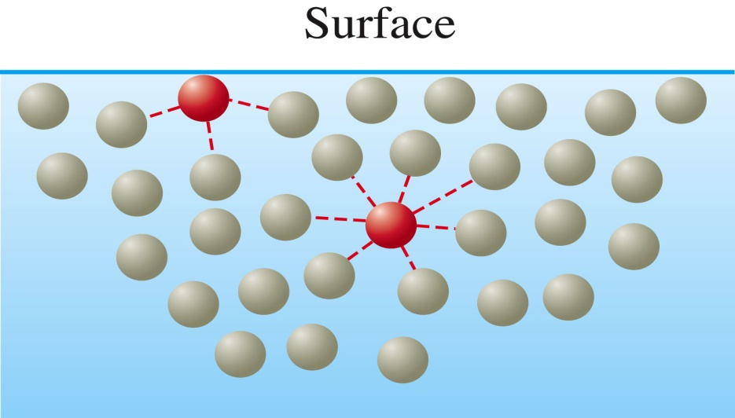
The liquid state
Surface tension
When a liquid is poured onto a solid surface, it tends to bead as droplets, a phenomenon that depends on the intermolecular forces.
Figure 16.6 - A molecule in the interior of a liquid is attracted to the molecules surrounding it, whereas a molecule at the surface of a liquid is attracted only by molecules below it and on each side of it.
The effect of this uneven pull on the surface molecules tends to draw them into the body of the liquid and causes a droplet of liquid to assume the shape that has the minimum surface area –a sphere.

Slide 15
The liquid state
Surface tension
To increase a liquid’s surface area, molecules must move from the interior of the liquid to the surface. This requires energy, since some intermolecular forces must be overcome.
The resistance of a liquid to an increase in its surface area is called surface tension of the liquid.
Liquids with high intermolecular forces have relatively high surface tensions.

Slide 16
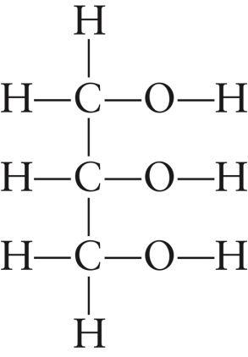
The liquid state
Viscosity
Viscosity: a measure of a liquid’s resistance to flow.
Liquids with large intermolecular forces tend to be highly viscous.
Molecular complexity also leads to higher viscosity because very large molecules can become entangled with each other.
- nonviscous gasoline: molecules of the type CH₃-(CH₂)_{n}-CH₃ (n from 3 to 8)
- viscous grease: much larger molecules (n from 20 to 25)
Glycerol has an unusual high viscosity mainly because of its high capacity to form hydrogen bonds.

Slide 17
HOMEWORK
Chap.16: 15, 20, 21, 27

Slide 18
15
Identify the most important types of interparticle forces present in the solids of each of the following substances.
Ar h. NH₄Cl
HCl i. Teflon, CF₃(CF₂CF₂)_{n}CF₃
c. HF j. polyethylene, CH₃(CH₂CH₂)_{n}CH₃
d. CaCl₂ k. CHCl₃
e. CH₄ l. NH₃
f. CO m. NO
g. NaNO₃ n. BF₃

Slide 19
20
Predict which substance in each of the following pairs would have the greater intermolecular forces.
CO₂ or OCS
SeO₂ or SO₂
CH₃CH₂CH₂NH₂ or H₂NCH₂CH₂NH₂
CH₃CH₃ or H₂CO
CH₃OH or H₂CO

Slide 20
21
Rationalize the difference in boiling points for each of the following pairs of substances:
a. n-pentane CH₃CH₂CH₂CH₂CH₃ 36.2°C
neopentane C(CH₃)₄ 9.5°C
HF 20°C
HCl -85°C
c. HCl -85°C
LiCl 1360°C
d. n-pentane CH₃CH₂CH₂CH₂CH₃ 36.2°C
n-hexane CH₃CH₂CH₂CH₂CH₂CH₃ 69°C

Slide 21
27
Explain why water forms into beads on a waxed car finish.

